Slide 1

Biotechnology
Big Data
Artificial Intelligence
Promises, Dangers, Worries, Gotchas
Abhijit Dasgupta, PhD Chief Data Scientist
Co-Founder
Slides available at https://webbedfeet.github.io/GMU_2019

Slide 2

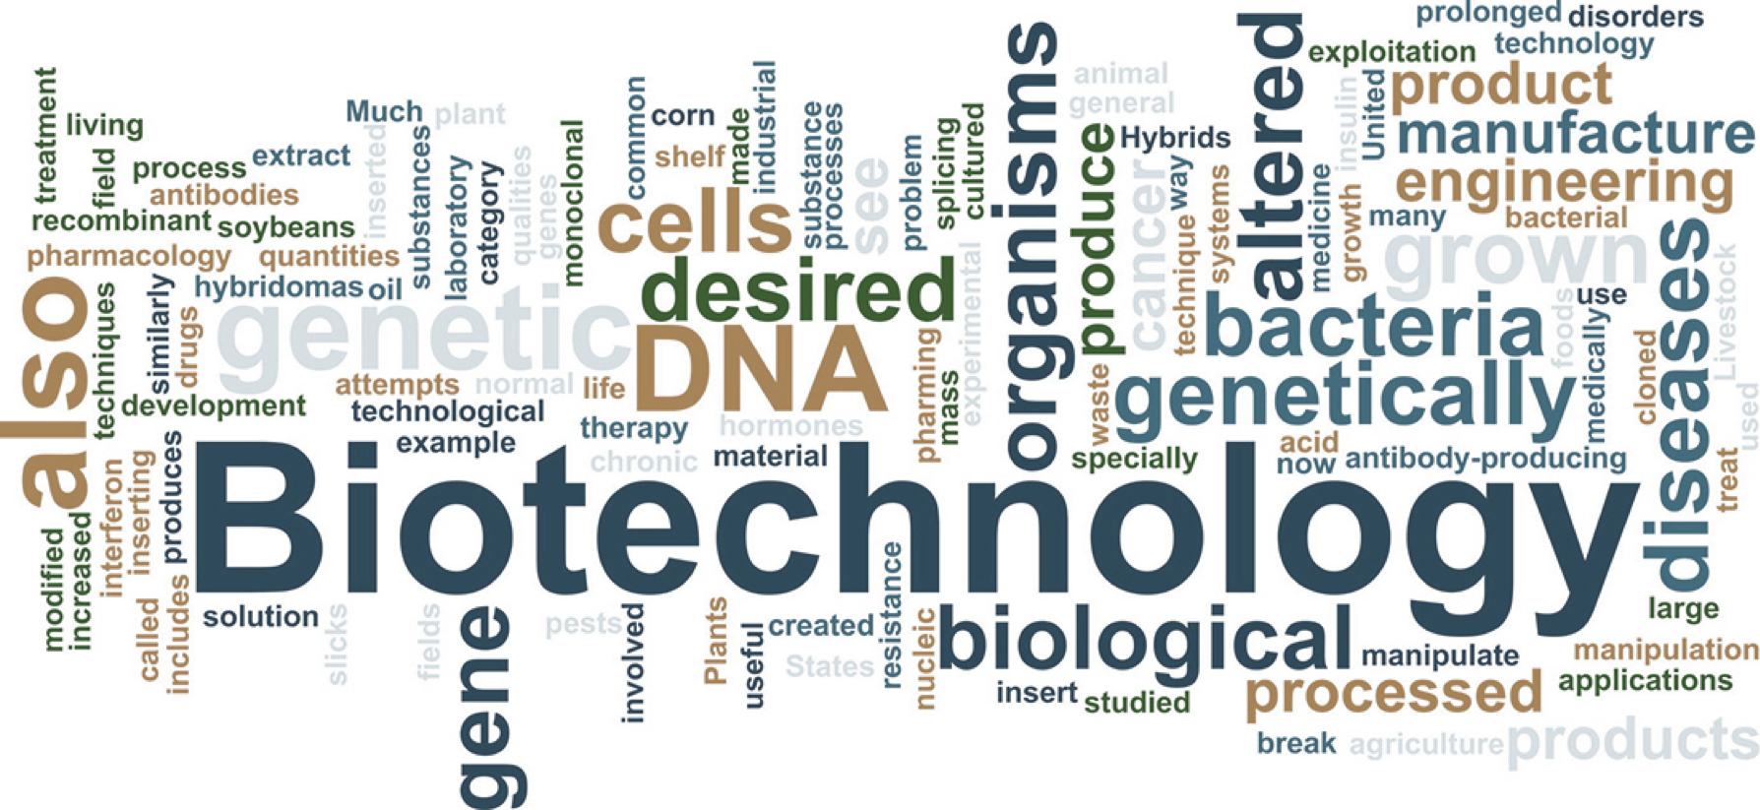

Slide 4
Business needs
Context (why we need it)
Discovery (Finding it)
Evidence of effectiveness
Reproducibility
Manufacturability
Quality

Slide 5

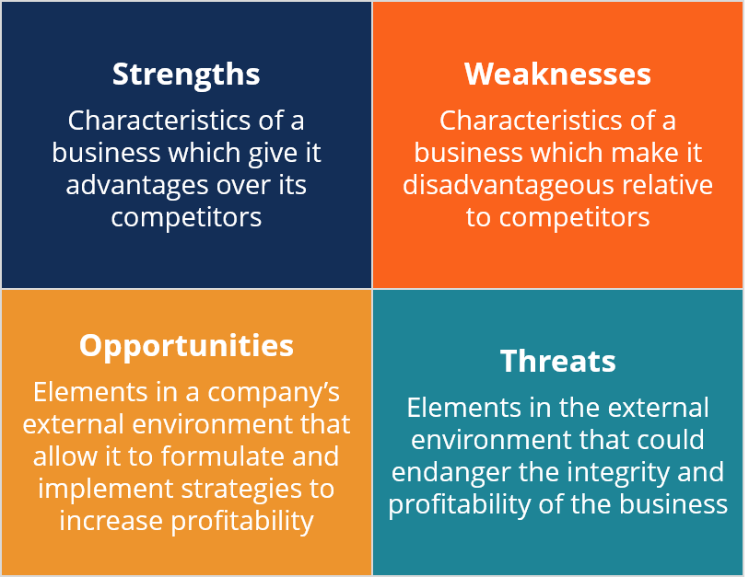

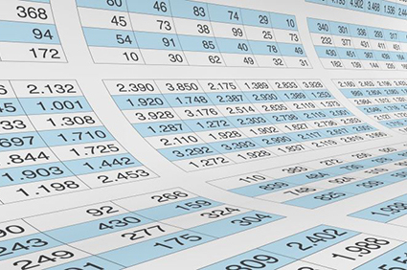

Context (why we need it)
Market research
Competition research
Focus groups
Gaps in the market
Market potential

Slide 6

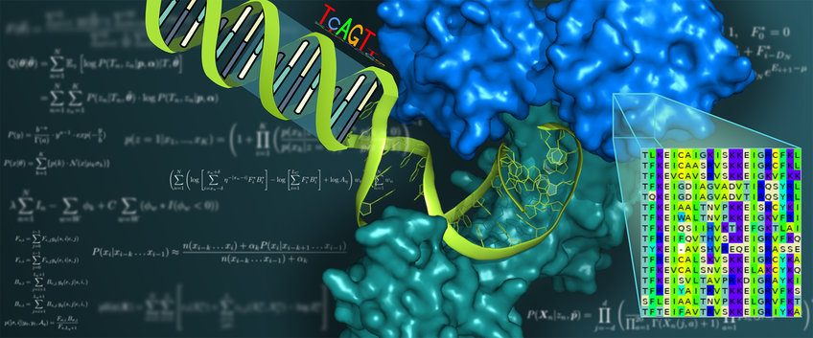
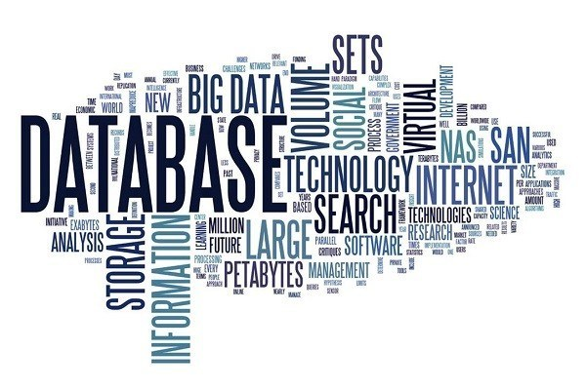
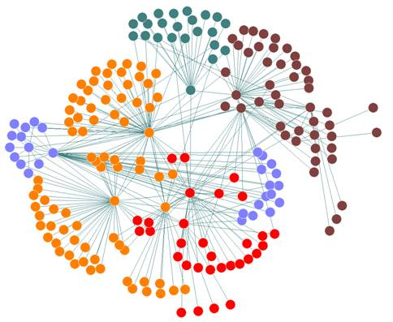
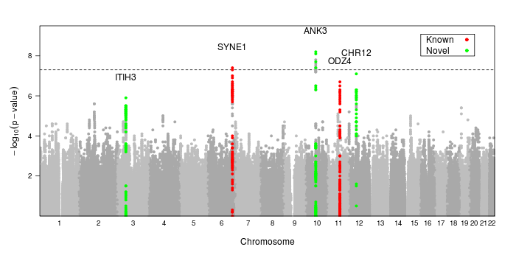
Discovery (finding it)
Identifying potential
Searching the literature
Searching databases
Analyzing relationships
Culling candidates

Slide 7

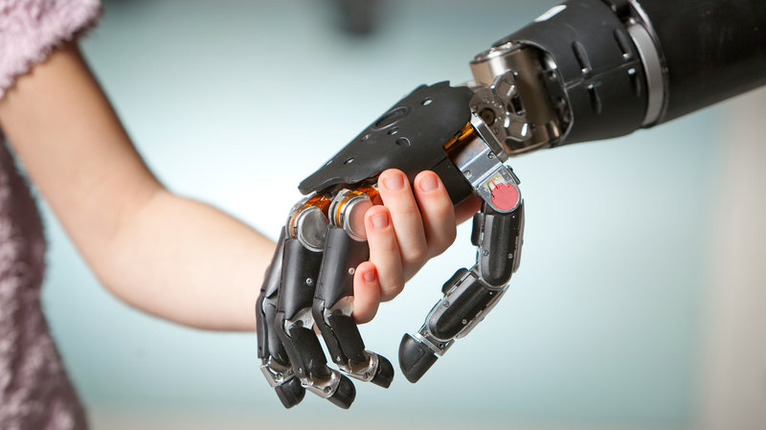


Evidence of effectiveness
Laboratory experiments
Field experiments
Observational studies
Randomized trials

Slide 8
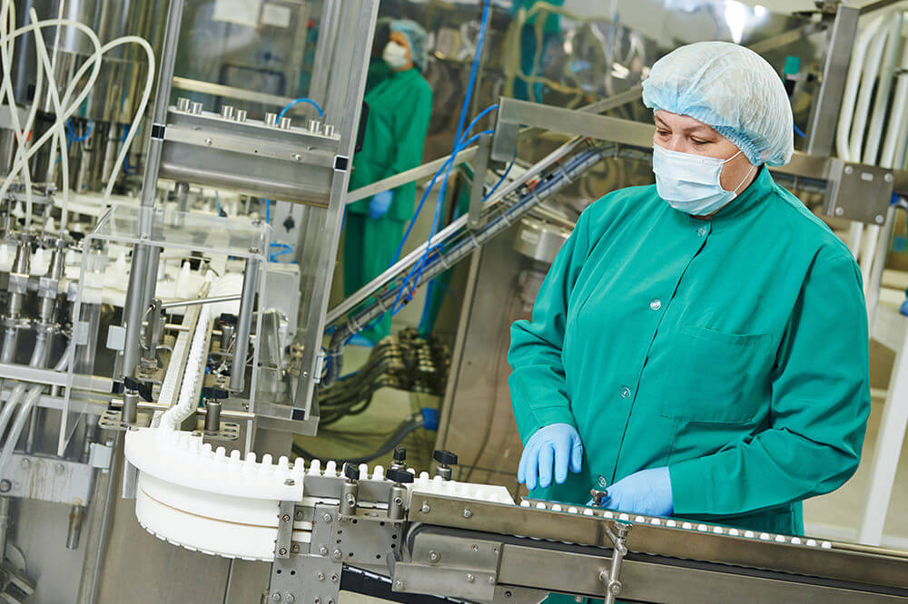
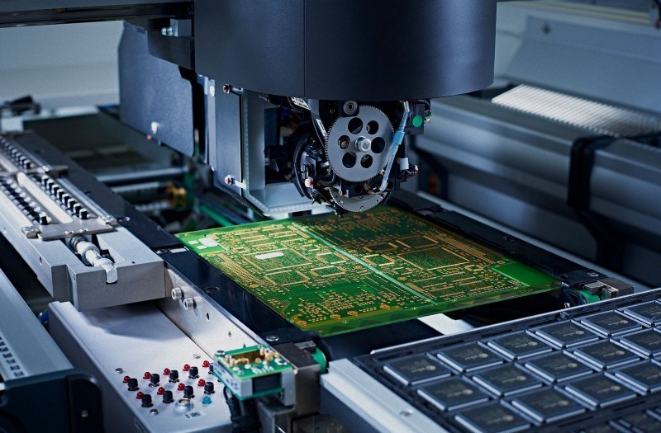

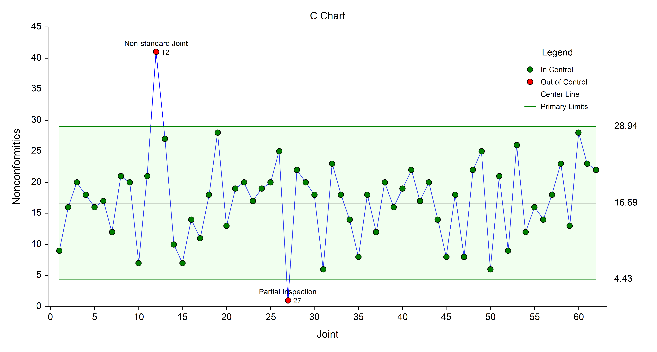
Manufacturability & Quality
Translation to a process
Establishing standards
Reproducibility
Quality control / Six Sigma

Slide 10
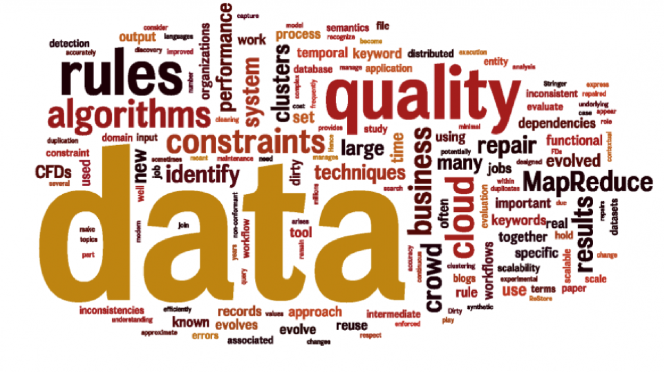

Slide 11
Research
Development
Production
Data drives
Marketing
Sales
Revisions

Slide 12
Central issue for data-driven business
The data must be reliable and valid
Repeating the experiment must yield similar results (reliability)
We’re measuring what we think we’re measuring (internal validity)
The results can be generalized to larger populations (external validity)

Slide 13

Central issue for data-driven business
This is a matter of trust
If the foundational data on which the business is built isn’t trustworthy, you can’t sell anything
$9 billion
Poof!

Slide 14
Central issue for data-driven business
It doesn’t matter how much data you can get
It matters how you got it
Experimental design
Ethics
Provenance

Slide 15
Central issue for data-driven business
It doesn’t matter how much data you can get
It matters how you use it
Analytics
Translation to business practice
Follow-up

Slide 16
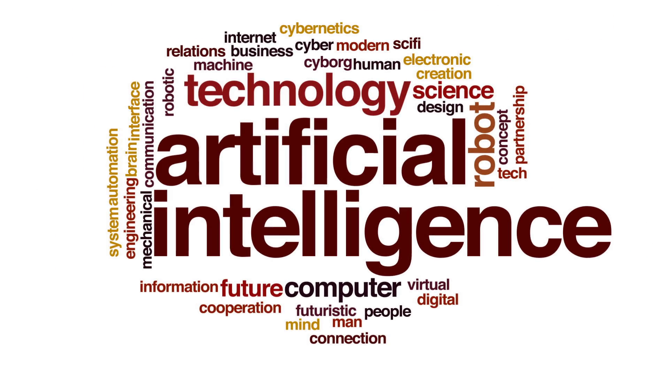

Slide 17
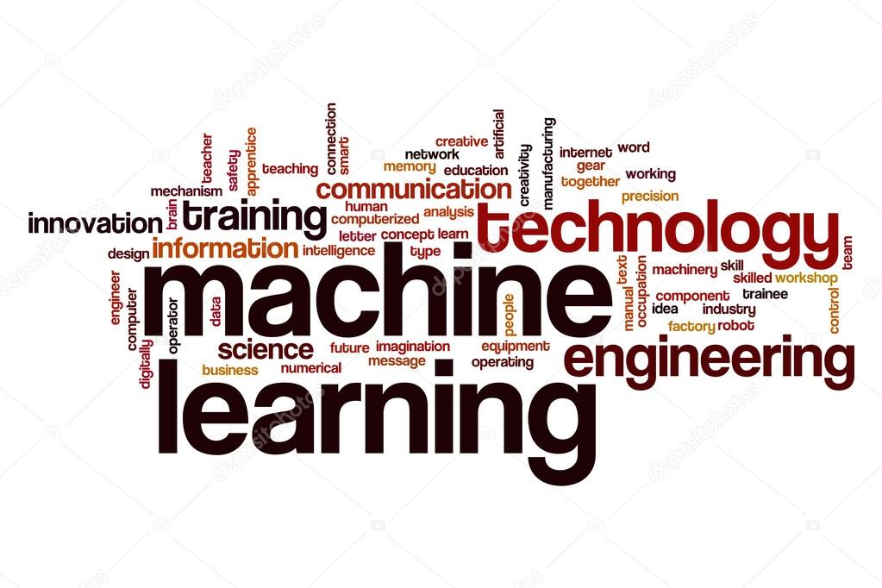
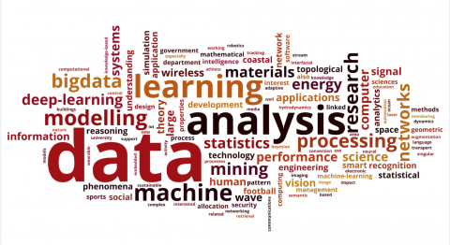
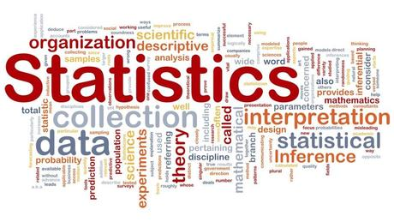

Slide 18
What is AI?
The ability of machines (computers) to learn, reason and act on their own
The ability of machines to demonstrate intelligence
The ability of machines to be autonomous, independent, and make decisions based on their environment

Slide 19
AI in Biotech
Drug discovery
Culling through millions of candidates to identify the next molecule for drug development
Patient management and decision support
Fast analytics to provide likely causes, drug effects and interactions, risks and side-effects based on patient history, EMR mining and literature mining

Slide 20
AI in Biotech
Prosthetics/exoskeletons and predictive movement
Environmental assessment and closed-loop therapeutic deployment
Performance optimization through sensing, adaptation and intelligent coaching
Precision medicine
Identifying therapies better targeted at the individual

Slide 21
Are we there yet?
Not really
Self-driving cars and planes on auto-pilot
Experimental situations
Some medical decision support

Slide 22
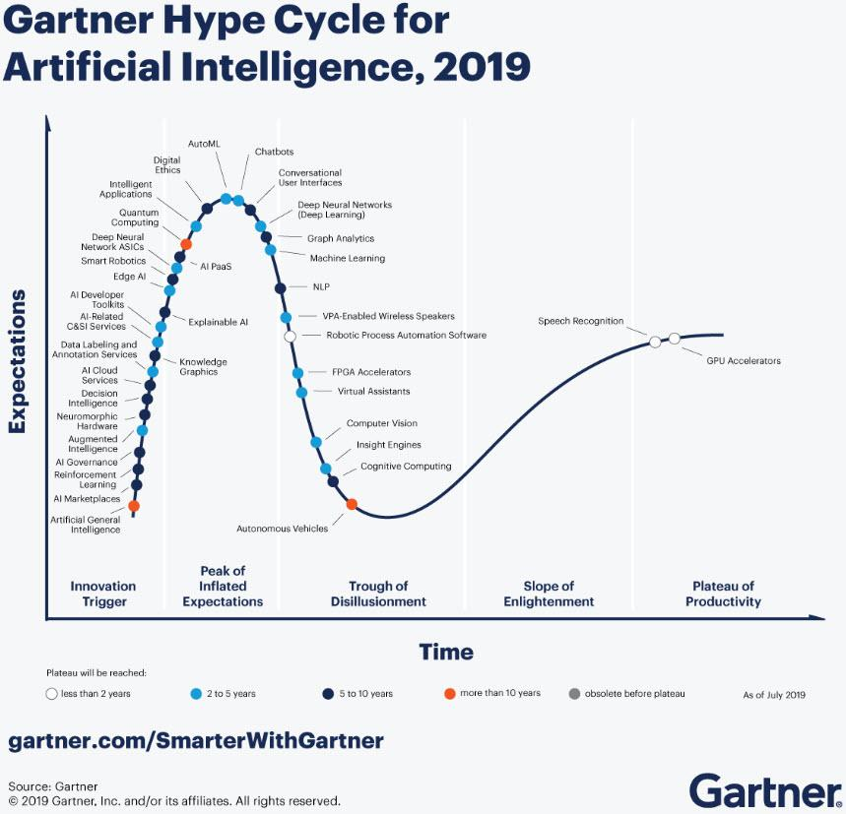
Are we there yet?
Gartner Hype Cycle 2019

Slide 23

So where are we?
Common use

Slide 24
Machine learning
Artificial intelligence is about learning, reasoning and acting
We are still trying to get the learning part down well
Learning innate patterns in data
Learning how an outcome is influenced by different factors
Learning to predict the future by observing the past
Learning to discern what is real and what is artifact

Slide 25
Machine learning success stories
Breast cancer therapeutics
Bioinformatics used to understand innate differences in different types of BrCa, leading to very successful targeted therapeutics
Tamoxifen, Herceptin, Fluoracil, Paclitaxel

Slide 26
Machine learning success stories
Identification of subgroups in various diseases, leading to more targeted interventions
EGFR & Lung Cancer
APoE & Alzheimer’s prevention
BRCA & Breast cancer prophylaxis
Immunotherapies
Gene editing (CRISP-R)

Slide 27
Machine learning success stories
Risk assessment, epidemiology and causality
Cancer risk prediction
Gail model for Breast Cancer
Impact of inflammation on health
Identification of genetic and proteomic risk factors in complex disease

Slide 28
What is ML?
Algorithms that ingest data and adapt to mimic and express inherent data patterns
Learns from data
Can provide predictions
Algorithms can be
Simple (linear regression)
Complex (decision trees)
Indecipherable or magical (neural networks / deep learning)

Slide 29
What is ML?
Algorithms that are mainly meant for prediction
Supervised learning
They cannot often express why the predictions happen
What factors influenced the prediction in what way?
It’s a function of the complexity of the model and our inability to express or comprehend that complexity easily

Slide 30
ML and Big Data
Machine learning is a greedy, hungry, voracious animal with respect to data

Slide 31
ML and Big Data
Complex models require a lot of data to work well
Deep learning works for Google and Facebook because of their data stores
So we have been collecting lots of data in the hope (and prayer) that we can learn from it
And, by lots, I mean….

Slide 32


Slide 33
Big Data in Drug Discovery
Pharma is losing patent control
Getting a drug to market requires many years and billions of dollars
However, we have plenty of clinical, bioinformatic, molecular and trial data

Slide 34
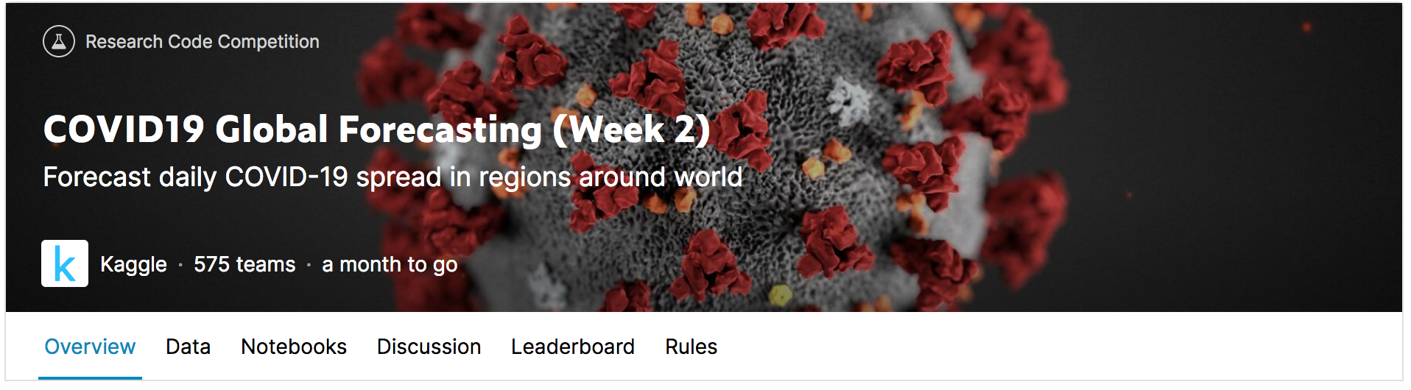
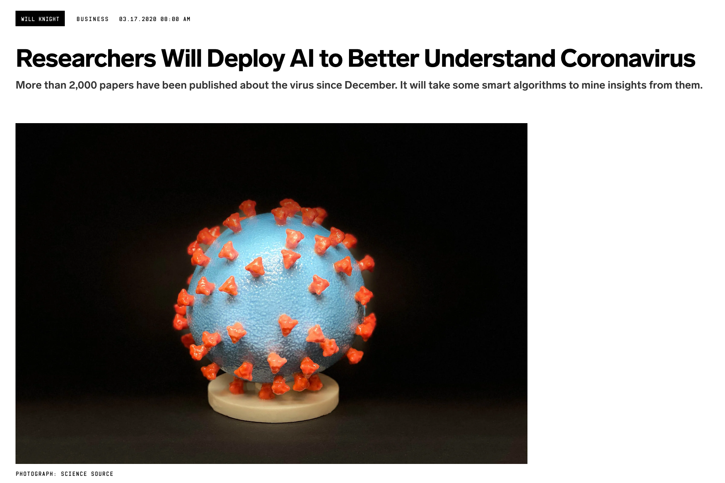
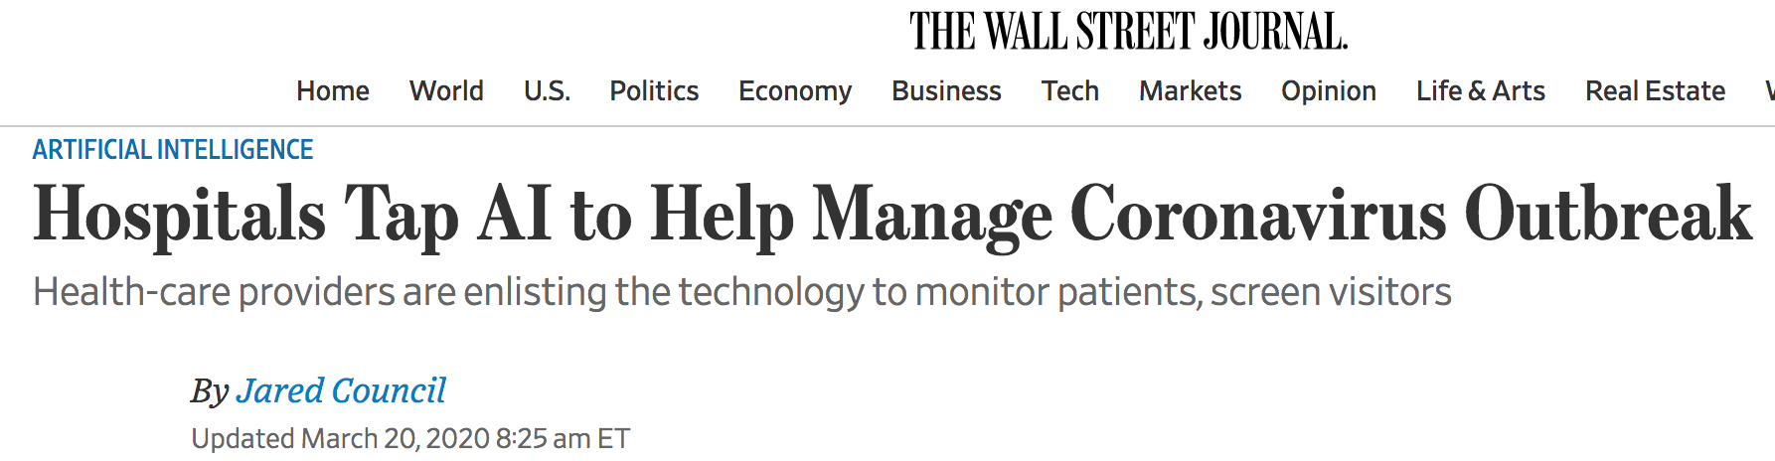
AI and coronavirus

Slide 35


Slide 36
A bright idea
Let’s mine this data for good candidate molecules
No assays, just data
To confirm, outsource to do targeted assays

Slide 37
Grab public data. Start a company. Sell the company. Repeat
Dr. Atul Butte, UCSF, 2015
Data sitting still is useless Data needs to stay in motion
Data needs to get us someplace

Slide 38
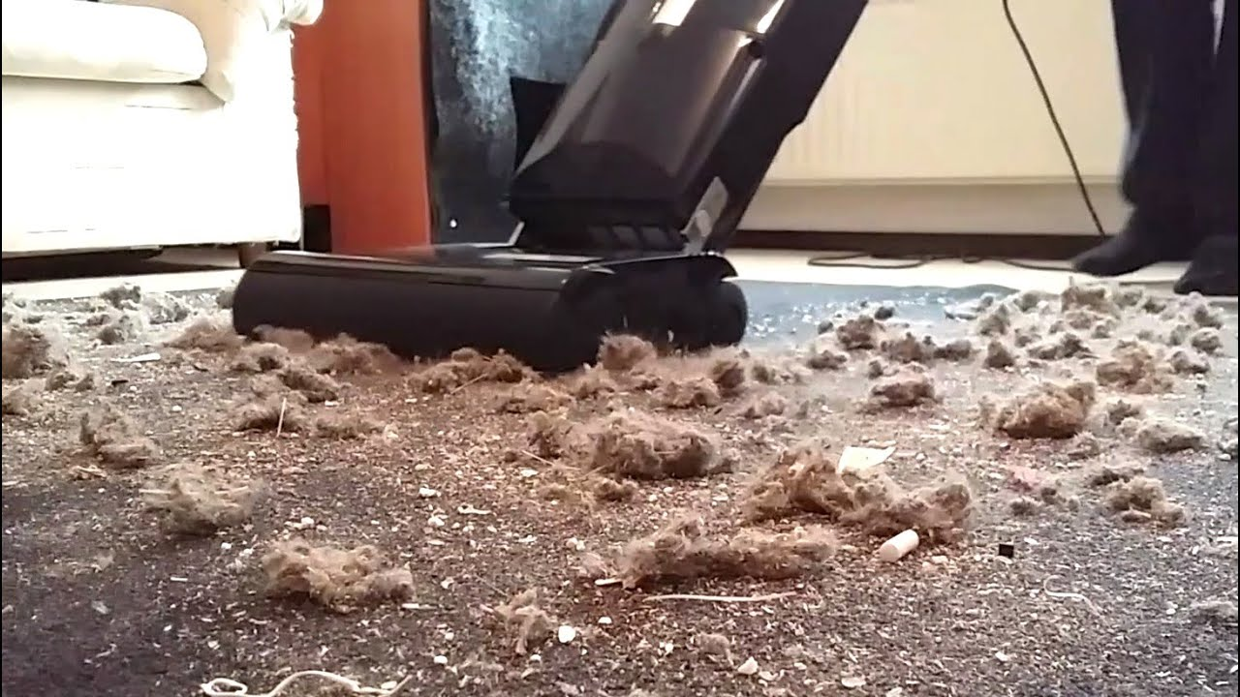
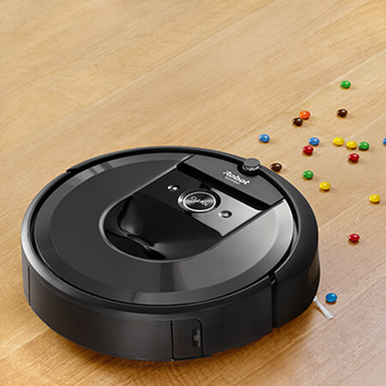
Where’s the data

Slide 39
Where’s the data
Our bodies
Genetic/proteomic/molecular code (1.5 Gb per cell)
Movement / behavior
Sleep
Gait
Sounds

Slide 40
Where’s the data
Interactions with the world
Health records and Insurance
Government data
Telecommunication
Social media
Economic behavior

Slide 41
Where’s the data
Data we voluntarily give, maybe inadvertently
Sensors we wear and carry
Movement through GPS (Google Maps, anyone
Electronic communication
Economic activity

Slide 42
Where’s the data
Data we voluntarily give, by choice
Medical and health data
Surveys

Slide 43
All told, 2 Zb* per year
*A Zb is 10²¹ bytes

Slide 44
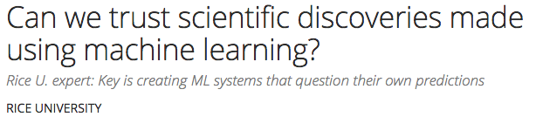
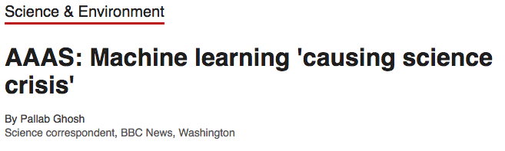
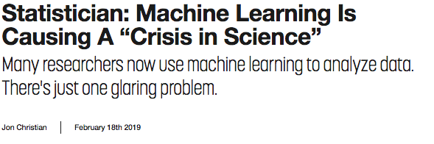
February 16, 2019

Slide 45
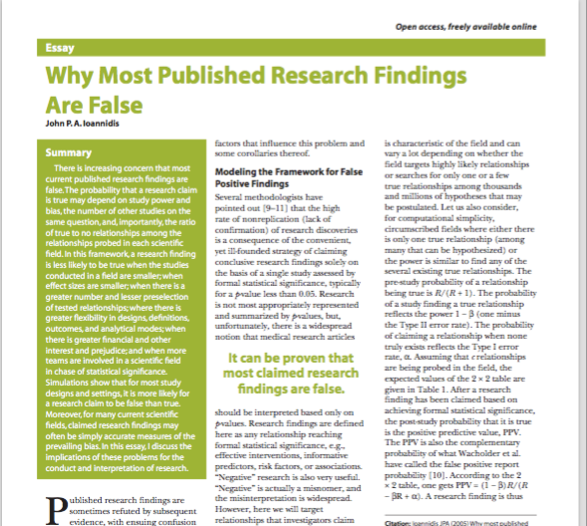
Pharma report:
89% of research findings are not reproducible
This has huge implications for biotech and pharma development, right?!!

Slide 46
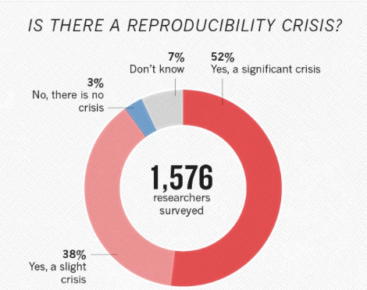
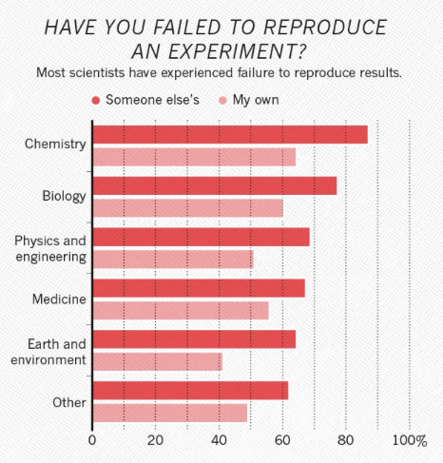

Slide 47
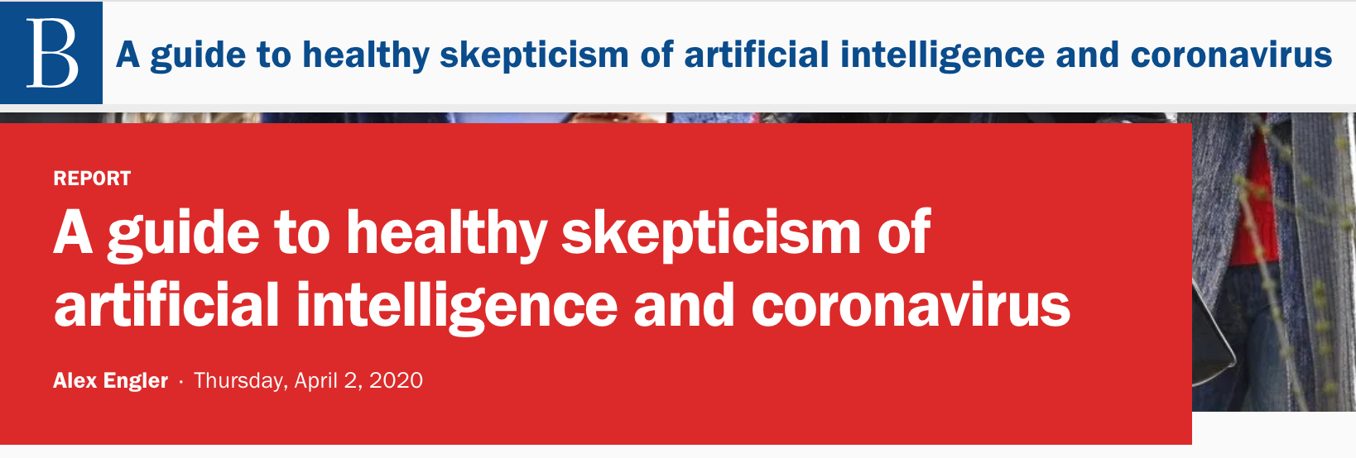
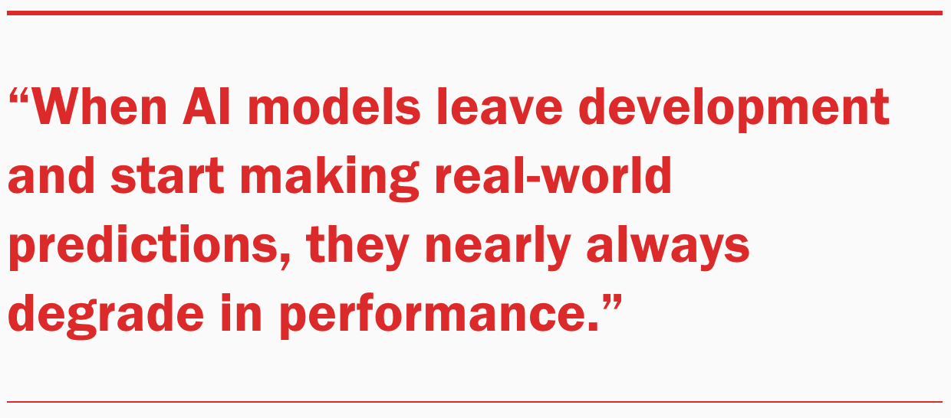
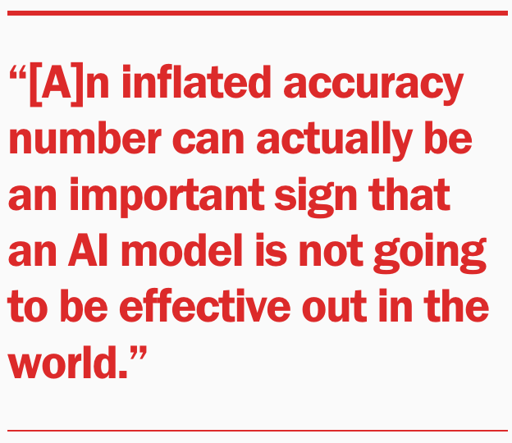
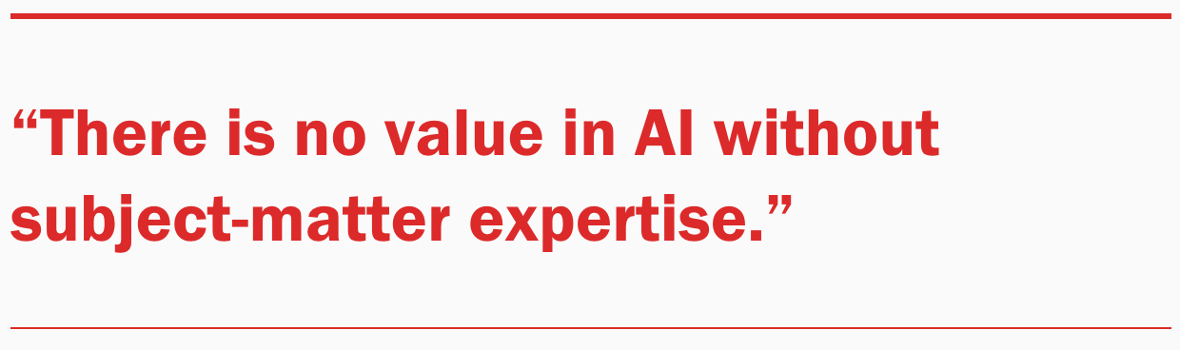

Slide 48
Issues with Big Data
Variability — Inconsistencies in the data
Veracity — Poor data quality
Complexity — Data management challenges
These are really the more pressing challenges
This is behind most of the problems!

Slide 49
Data is NOT information
Data is just that, data
It only contributes to information when given a context (your question)
In that context, the data-derived information can be translated into action
Products
Services

Slide 50
The question drives the learning Not the other way around

Slide 51
My personal experience
You’ve got data
I need data and a question
80% of my time will be to help you figure out the question
80% of the remaining time will be spent getting your data into a usable state for your question
Need to find the right Big Data for your question
Need to see if your question is answerable given available data

Slide 52
Biases and ethics
Our learning is only as good as the training data that is used
Training data is often biased
Funding biases
Historical biases
Incompatibilities

Slide 53
Biases and ethics
Genomic and pathway databases ingest the scientific literature
The relative volume of literature in various fields is driven by funding
Databases are biased to cancer, heart disease and diabetes
Good luck if you have a rarer disease to treat

Slide 54
Biases and ethics
Historically, minorities had lower chances of getting loans, mortgages, etc.
This is reflected in the historical data
This data is used to train ML models
Now the historical racial bias is codified, since the models will make predictions based on patterns it saw in the training data
Similar issue with clinical trials
Most studies were done on middle aged white men
Do these data apply to women, children, other ethnicities?
Huge issue recognized in data ethics

Slide 55
Biases and ethics
aka, we like shiny new things
Historical bioinformatic data incompatible with currently produced data
We have lost the opportunity to use this large corpus of data
Billions of dollars in international funding
We can’t tell how these data relate to current findings easily

Slide 56
Garbage in, garbage out
Make sure the data you’re leveraging for your business and your career is of the highest quality
Provenance
How it was collected
How it is stored

Slide 57
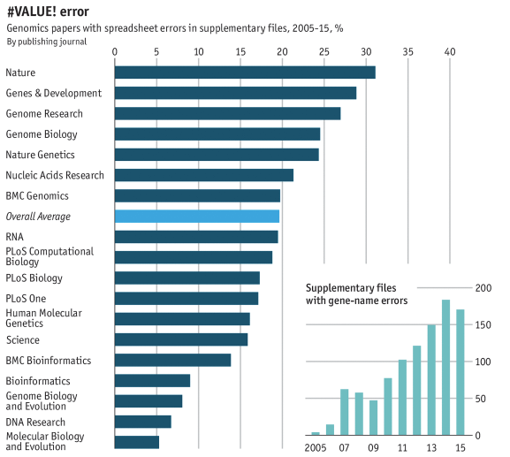
Garbage in, garbage out

Slide 58
Garbage in, garbage out
Make sure you use the data
Appropriately
Ethically
Really think through and understand your data, your question, and how they relate
Don’t just dump things into AI just because it’s the cool thing

Slide 59
Big Data + ML/AI ≠ Sorceror’s Stone
Big Data can mean Big Noise
No signal to be had
ML will give spurious, irreproducible answers
Dietary studies are notorious for this, as are psych studies

Slide 60
Big Data + ML/AI ≠ Sorceror’s Stone
Finding and assessing rare events is VERY HARD
Suppose an event occurs in 1 out of 10,000 people
You fit a ML model to this huge database (think Medicare)
I use the amazing “Ostrich Method”: Just say no
I’ll have an accuracy of 99.99% in this scenario
Beat that, you fake intelligence.

Slide 61
The crystal ball
Storage costs are a huge issue
Analytic methods need progress
Still leveraging methods from 20 or more years ago
A fast moving area

Slide 62
The crystal ball
Lots of unusable data
Lack of compatibility
Lack of documentation
More efficiency and focus needed
Data generation
Data analysis
Data products
Symbiosis

Slide 63
“Begin with the end in mind”
Find a problem that needs solving
Find the tools, data and methods that will help you figure it out
Create a diverse team (in skills, talent and background)
Work as a team to develop a product that solves it
Use evidence-based best practices to convince the market that your’ve solved it

Slide 64
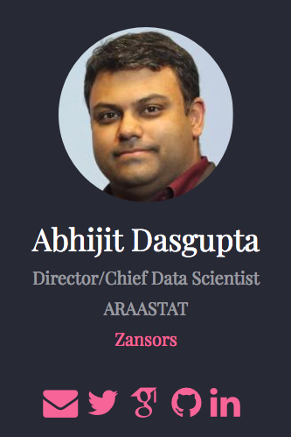
Contact info
abhijit@zansors.com
@webbedfeet / @Zansors
https://webbedfeet.netlify.com

